Slide 1

Writing for the web
Jo Spiller & Ross Ward
Learning Technology Section
College of Medicine and Veterinary Medicine
University of Edinburgh

Slide 2

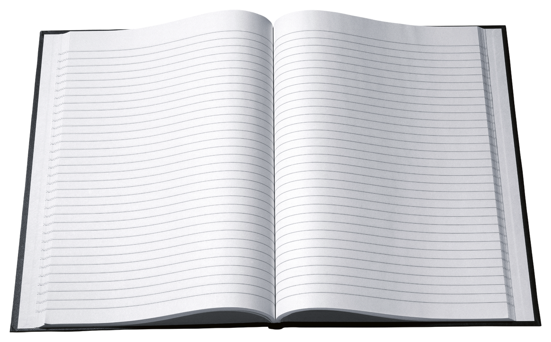
8 Guiding Principles for Web Writing
Totally different to writing for print
We tend to scan content rather than read word-for-word

Slide 3
1. Use Clear and Simple Language
Reading from the computer screen is tiring for the eyes and 25% slower than reading print
Tips
  Avoid slang or jargon
  Use shorter words where possible
  Avoid complex sentences
  Use active rather than passive

Slide 4
2. Limit each paragraph to one idea
Readers can then:
  Easily scan through each paragraph
  Get the gist
  Move on to the next paragraph
There is no fear that they’ll be skipping over important information

Slide 5
3. Front-load content
Means putting the conclusion first
Followed by the what, how, where, when and why.
Users can
  Quickly scan through the opening sentence
  Instantly understand what the paragraph is about
  Decide if they want to read on…

Slide 6
4. Use descriptive sub-headings
Readers can then:
  See what each section of the page is about.
There is no rule on frequency but suggestion is one every 2 to 4 paragraphs
Should gropu page content into logical groups

Slide 7
5. Bolden important words
Readers can then scan the page and this text stands out
Bolden two or three words which describe the main point of the paragraph
Readers can instantly gain understanding of what the paragraph is about.

Slide 8
6. Use descriptive link text
‘Click here’ makes no sense
To find out the destination, users must scan the before and after link text

Slide 9
7. Use lists
Preferable to long paragraphs because:
Users can read the information vertically rather than horizontally
Are easier to scan
Are less intimidating
Are usually more succinct

Slide 10
8. Left-align text
Left-aligned text is easier to read than justified text.
The spacing in justified text is different between each word so our eyes have to search for the next word but justified text
Is easier to read
than centre-aligned text
Or right-aligned text

Slide 11
Conclusion
The 8 guidelines are nothing revolutionary
Not difficult to implement
Can work for a variety of web writing
Look at sites to see how often these guidelines are used
Some? All?

