Slide 1
Introductory Questions…
How many new patients do you normally see in your department in a week?
Are there many variations that you deal with in terms of diagnoses and treatments?
What percent of your cases would you say are “Textbook cases”?
Do you have enough time for teaching?
Do you know what Virtual Patients are?

Slide 2

Virtual Clinic Workshop
Blantyre
May 2011
Jo Spiller & Ross Ward
Learning Technology Section
College of Medicine and Veterinary Medicine
University of Edinburgh

Slide 3
Virtual Clinic – what is it?
Similar to Virtual Patients
Case-based learning
Simulations of real world scenarios
Data that reflects real patient records
Process of analysis of records or presentation
Presents choice
Decision-based
Notes:
Virtual Patient from admission to discharge.

Slide 4
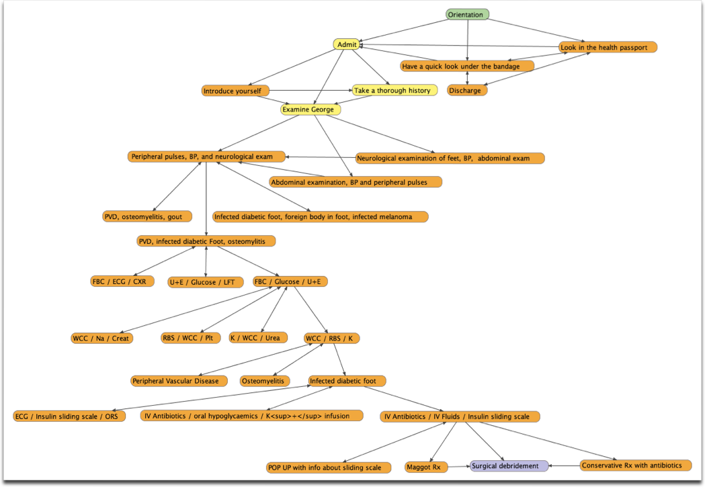

Slide 5
Virtual Clinic – why?
‘Safe’ clinical practice
Builds confidence
Exposure to wider range of patient
variations than ward rounds can offer
Not just text book cases but real-life anomalies
Anecdotal teaching transposed to virtual case
Reusable and valuable bank of patient cases (anonymised)

Slide 6
Key aims of these workshops
To build a bank of patient scenarios that can form the basis of a Virtual Clinic
To introduce Articulate Quizmaker as the vehicle for developing the clinic

Slide 7
Key outcomes of this workshop
To have brainstormed and built up a bank of potential patient/clinic scenarios
To have explored and developed at least one full patient scenario
To have transposed the scenario into Quizmaker

Slide 8
Generic template for the Virtual Clinic
1. Initial description of symptoms
2. Initial decision
3. Feedback and provision of more information
4. Decide on the next steps
5. Feedback and further information

Slide 9
Presentation
Choice 1
Choice 2
Choice 3
Choice 4
Feedback and more information
Choice 1
Choice 2
Choice 3
Choice 4
Feedback and more information

