Slide 1


Thinking TINTS
Jo Spiller
Learning Technology Section
College of Medicine and Veterinary Medicine
University of Edinburgh

Slide 2

Meet TINTS
There are TWO things you need to know about TINTS
He’s not familiar with this world
He needs your help

Slide 3

What’s this?
What do you do with it?
Why do you do it?
How do you do it?
What else should you know?
Notes:
What do you do – open and close
Why – to get in or out of a room, keep in heat or keep out heat
How – use a door handle, or push
What else – locks and keys, why? Security
I want to give TINTS all the information he needs to use any door he may find – even if I’m not there. Stepping out into this unfamiliar world TINTS will be met by many unfamiliar things which he will need to know how to use in order to function competently in this world.

Slide 4
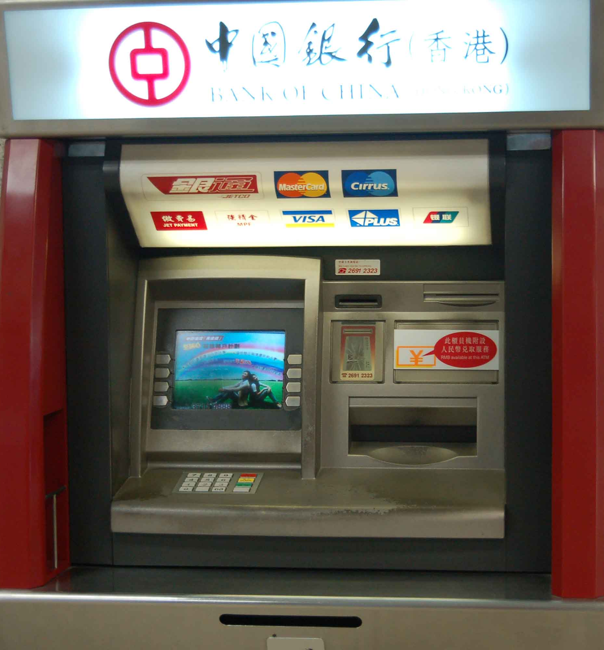
Help TINTS?
What is it?
What does it do?
Why do you need to know this?
How do you use it?
What else should you know?
Notes:
How do you use it - what assumptions will you make about his understanding and prior knowledge
What else?
You can't take out more money than you have in your account
If you put your PIN number incorrectly 3 times you'll lose your card
For security you should never write down your PIN no anywhere.

Slide 5
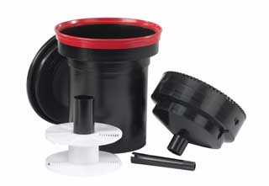
What about you?
What is this?
What does it do and why do you need to know this?
How do you use it?
What else do you need to know?
Notes:
Let’s turn this around now – it’s not only TINTS that will be unfamiliar with things in this world. You might too.
Answers
Development Tank
It’s used in the Development process
Is this enough information? Key words missing Camera Film

Slide 6
How do you use it?
Put the film on the spool
Put the spool in the tank
Add 3 different types of chemicals
    – developer, stop and fixer
Agitate for 5 secs in every minute for a number of mintues
Take the film out and wash thoroughly in water
Notes:
Key information missing –
what is the spool?
do I add the chemicals together or one after another?
Do I Mix them with water? What temperature?
What does ‘agitate’ mean? How long exactly?
What else – process needs to be done completely in the dark so need to break down this process further – how do you get film onto the spool
What do you do with the chemicals once you’ve used them – need to preempt questions that you might have

Slide 7
TINTS
There are TWO things you need to know about TINTS
He’s not familiar with this world
He needs your help
The most important this to know about TINTS
TINTS = This Is New To Students
Notes:
Be clear about the assumptions that you will make about knowledge in this unfamiliar world
Try to successfully preempt questions he might have

Slide 8
In order to help students understand an unfamiliar world…
Describe clearly what something is and what it does
Outline why they need to know this
Detail step by step what process to take
Detail variations within that process that are important
Explain any new, unfamiliar terms that you use
Preempt the questions they might have and answer them
because YOU WON’T BE THERE

