Slide 1


Thinking TINTS
Jo Spiller
Learning Technology Section
College of Medicine and Veterinary Medicine
University of Edinburgh

Slide 2

Meet TINTS
There are TWO things you need to know about TINTS
He’s not familiar with this world
He needs your help

Slide 3
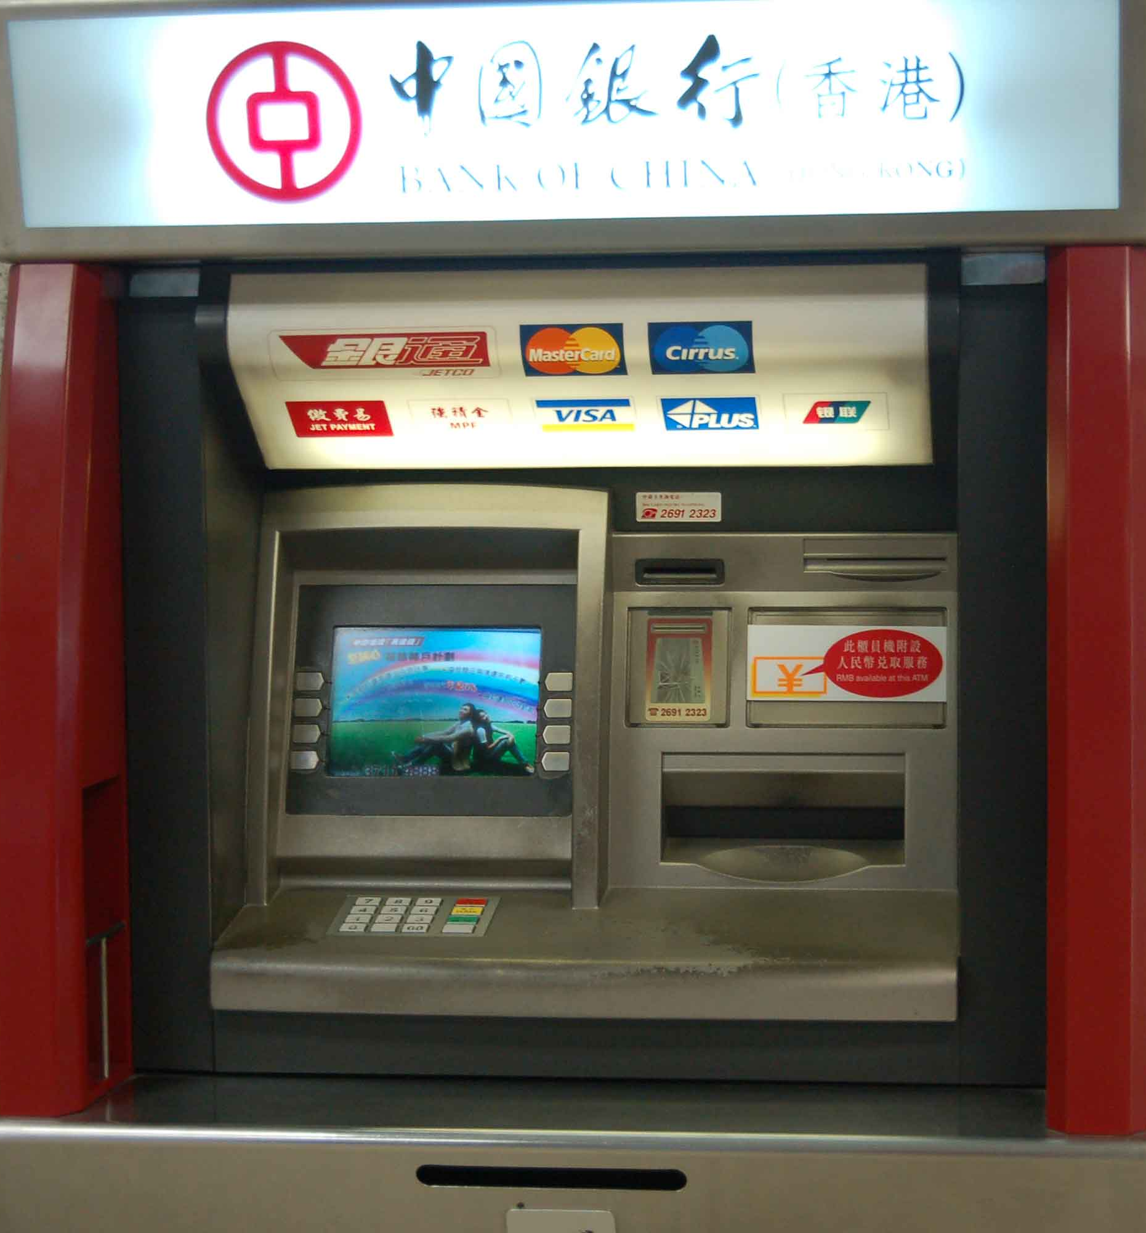
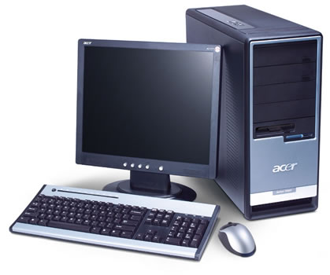
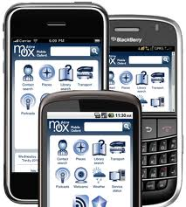
He’s in an unfamiliar world
Full of unfamiliar concepts

Slide 4
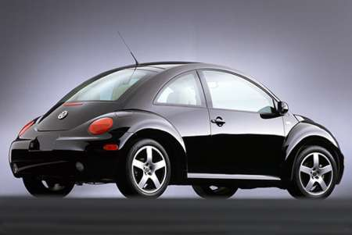
Help TINTS?
What is it?
What does it do?
Why do you need to know this?
How do you use it?
What else should you know?
Notes:
How do you use it - what assumptions will you make about his understanding and prior knowledge
What else?
You can't take out more money than you have in your account
If you put your PIN number incorrectly 3 times you'll lose your card
For security you should never write down your PIN no anywhere.

Slide 5
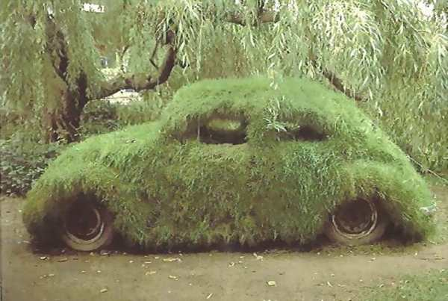
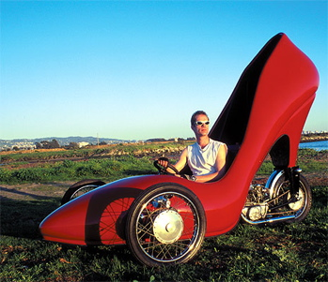
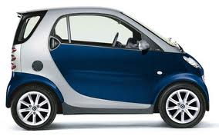
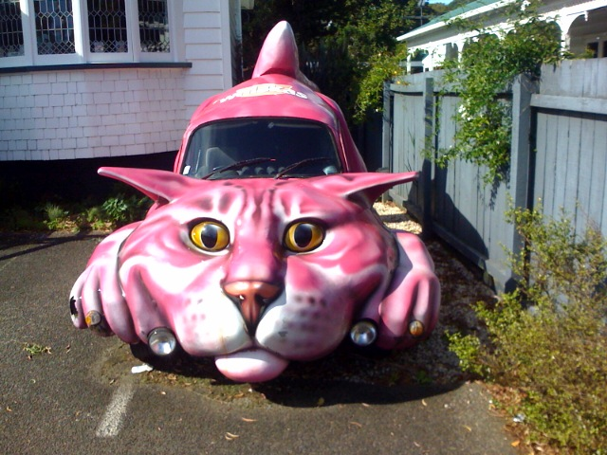
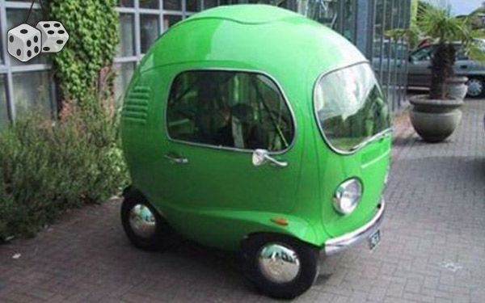
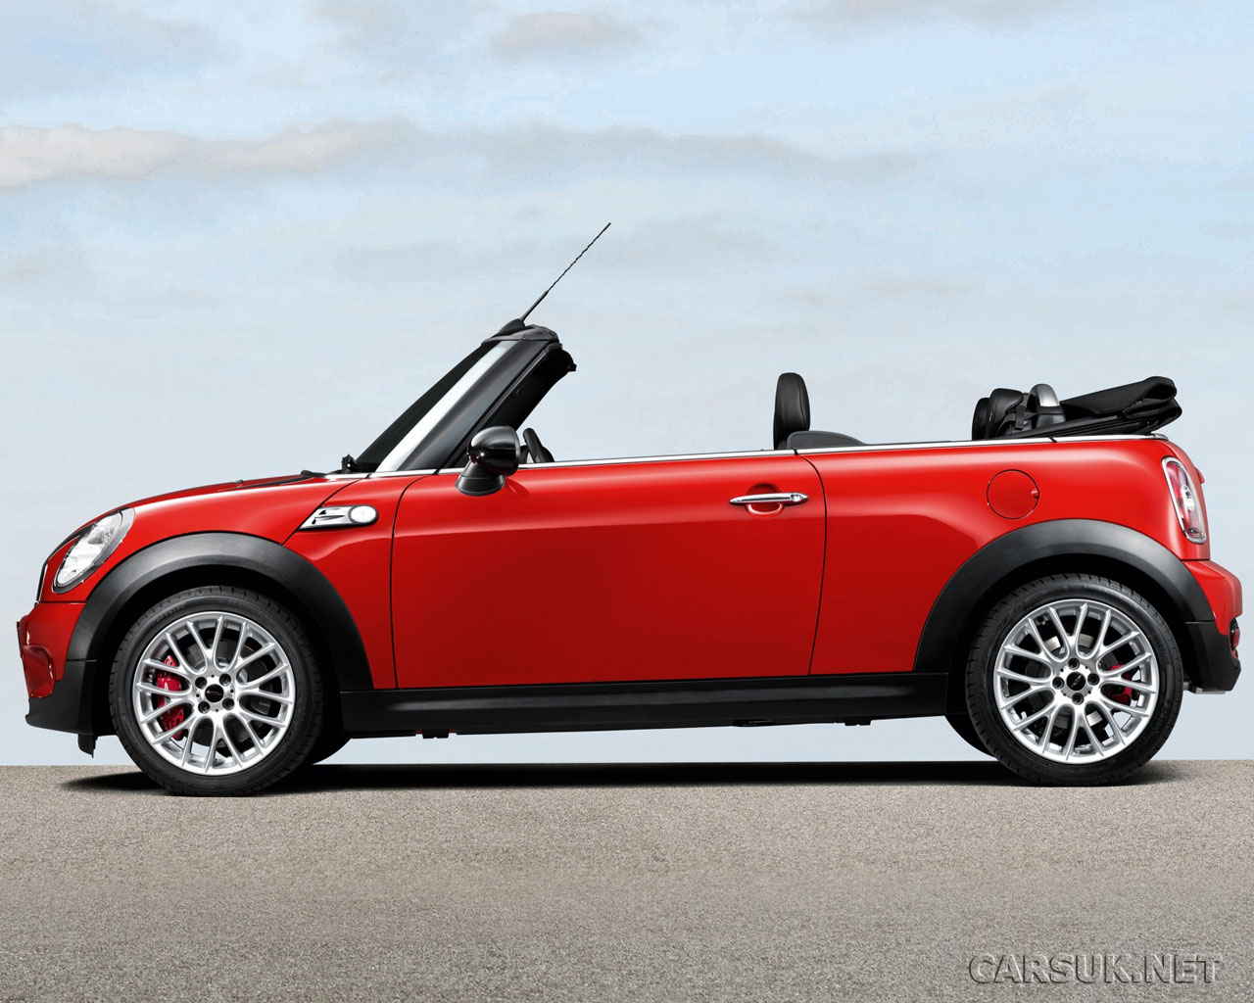
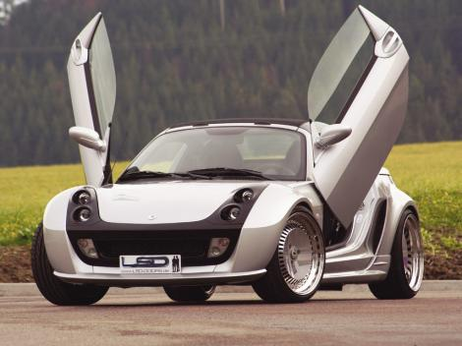
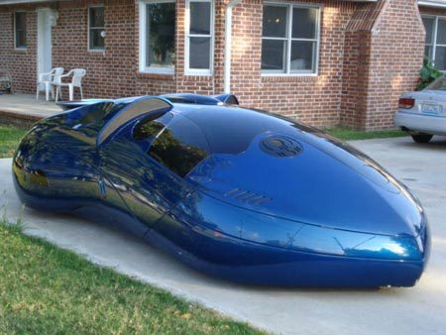
Notes:
Types of cars

Slide 6
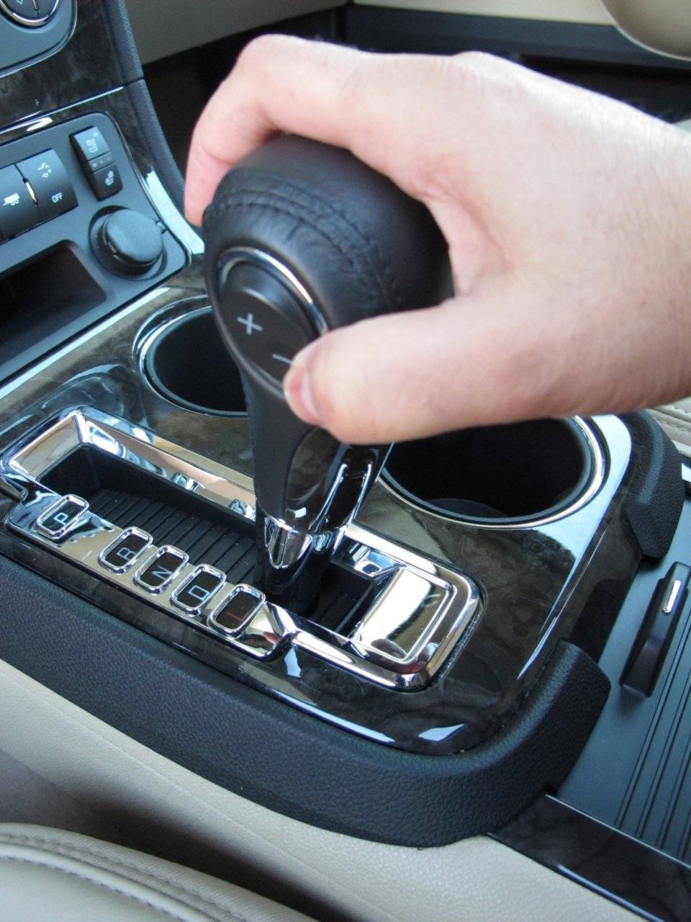
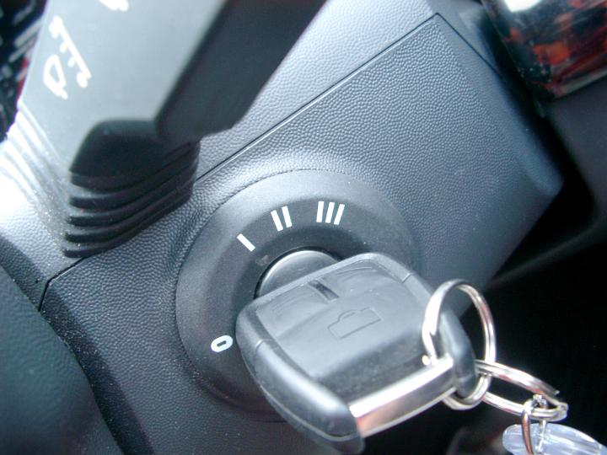
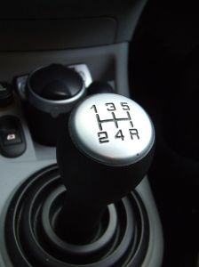
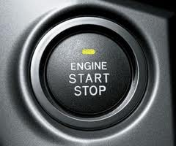
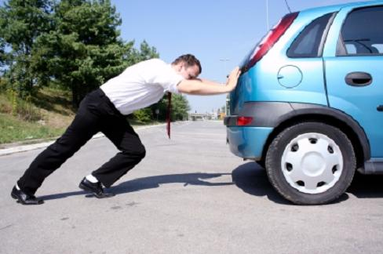
How to use a car…
Notes:
Keys and gear sticks
Processes and Types

Slide 7
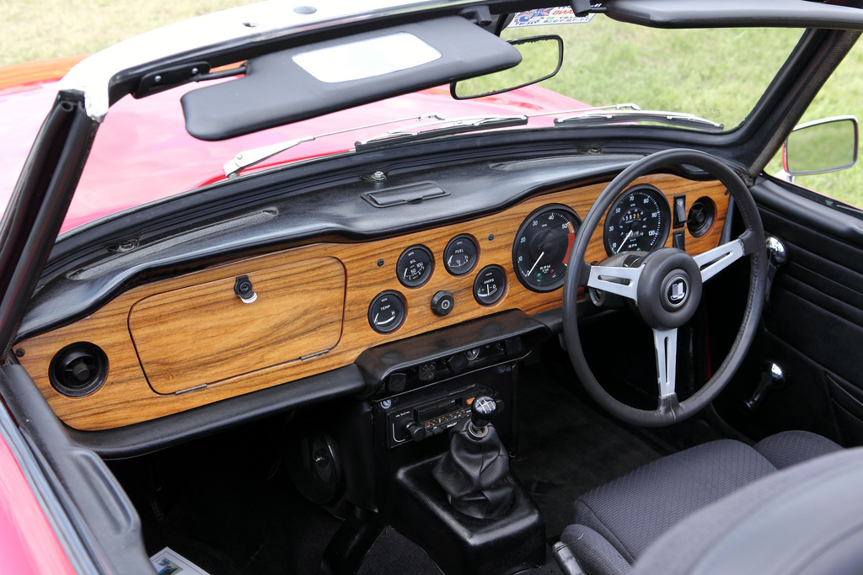
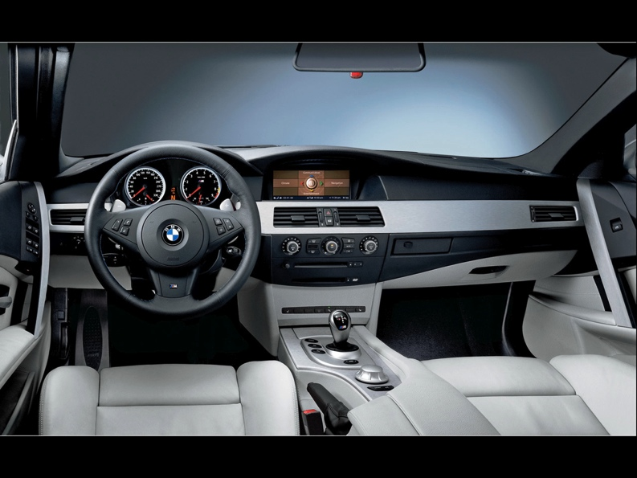
Where to find everything…

Slide 8
Professional processes
Manual removal of the placenta
Insertion of a cannula
Venipuncture
Recording temperature
Resuscitation
Suture Removal
Vacuum drain
Blood Glucose monitoring
Notes:
Be clear about the assumptions that you will make about knowledge in this unfamiliar world
Try to successfully preempt questions he might have

Slide 9
TINTS
There are TWO things you need to know about TINTS
He’s not familiar with this world
He needs your help
The most important this to know about TINTS
TINTS = This Is New To Students

Slide 10
In order to help students understand an unfamiliar world…
Describe clearly what something is and what it does
Outline why they need to know this
Detail step by step what process to take
Detail variations within that process that are important
Explain any new, unfamiliar terms that you use
Preempt the questions they might have and answer them
because YOU WON’T BE THERE
Notes:
Processes, Types, Orientation diagrams.

Slide 11
Help TINTS…
Types of cars?
How to start a car?
Where to find what you need?
Notes:
Processes, Types, Orientation diagrams.

Slide 12
What did you do…?
Starting a new ‘interaction’ – tab, process, labelled graphic
Saving and previewing the ‘interaction’
Sourcing images
What else??
Notes:
Processes, Types, Orientation diagrams.

