Slide 1

Avoiding the Pitfalls
Good Practice in creating e-Learning Resources

Slide 2
What have we learned?
From you experiences in previous workshops what ‘Tips’ would you like to pass on to others?

Slide 3
Some of our tips…

Slide 4

Save your work
Remember to save your work
Give it a meaningful name
Keep your files together
  Use Folders
  Original Files and Published Files
Take a copy with you

Slide 5
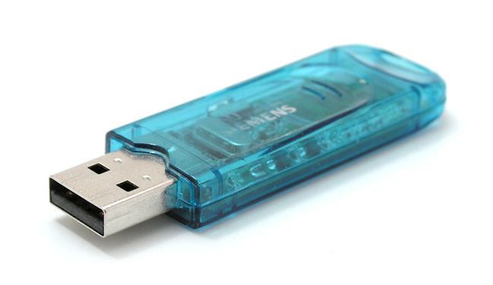
USB Flash Drives
Remember to work on the computer
Use the USB Flash Drive as a backup
Remember to take it with you
Watch out for Viruses

Slide 6
Plan your resource
Will it add value?
Has somebody else created something like it?
What information do I need to convey?
What is the best software to use?

Slide 7
Graded Question or Survey Question
Graded
Survey
Has a right or wrong answer
Can have a score applied to it
Has more feedback options
  Right or Wrong
  Specific feedback on some question types
Used when there maybe isn’t a right or wrong answer
Feedback can be more general

Slide 8
Copy and Paste Problems
Sometimes copying and pasting has its issues…
Bad formatting
Unusual characters
Bad spelling

