Slide 1
Diabetes
Adamson

Slide 2
Introduction
What is diabetes

Slide 3
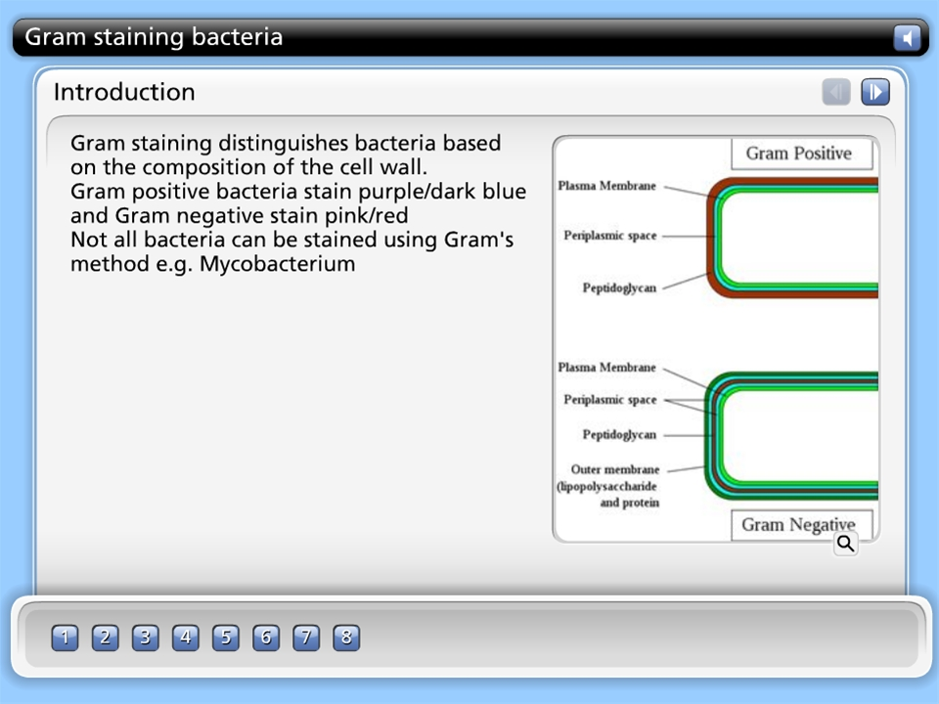



Gram staining bacteria

Slide 4
Clinical features
Thirsty
Fatigue

Slide 5
Laboratory investigations
Blood test

