Slide 1

Virtual Clinic Workshop
Blantyre
May 2011
Jo Spiller & Ross Ward
Learning Technology Section
College of Medicine and Veterinary Medicine
University of Edinburgh

Slide 2
Virtual Clinic – what is it?
Similar to Virtual Patients
Case-based learning
Simulations of real world scenarios
Data that reflects real patient records
Process of analysis of records or presentation
Presents choice
Decision-based

Slide 3
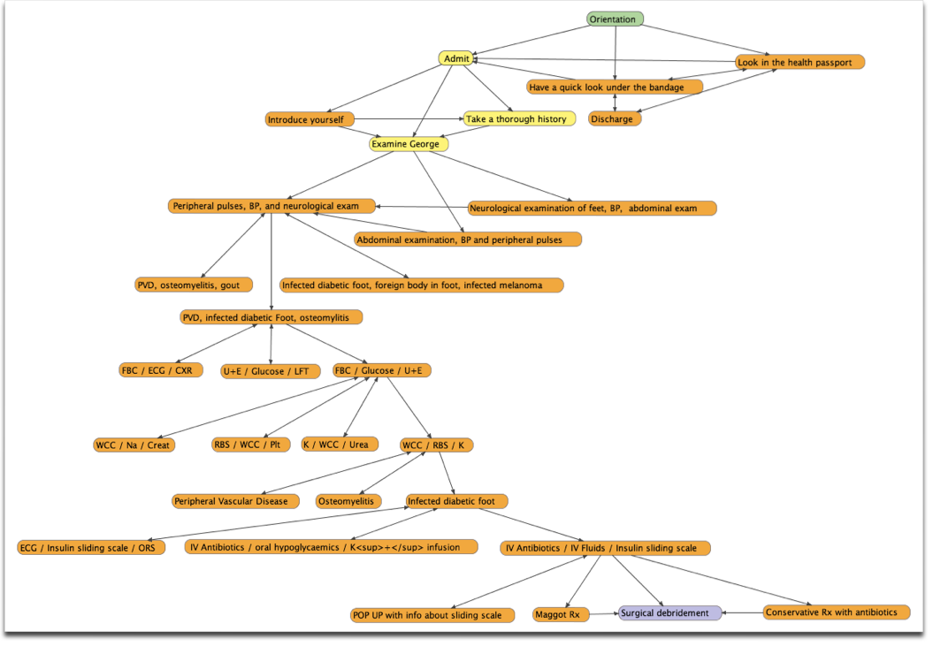

Slide 4
Generic template for the Virtual Clinic
1. Initial description of symptoms
2. Initial decision
3. Feedback and provision of more information
4. Decide on the next steps
5. Feedback and further information

Slide 5
Presentation
Choice 1
Choice 2
Choice 3
Choice 4
Feedback and more information
Choice 1
Choice 2
Choice 3
Choice 4
Feedback and more information

Slide 6
Key aims of these workshops
To build a bank of patient scenarios that can form the basis of a Virtual Clinic
To introduce Articulate Quizmaker as the vehicle for developing the clinic

Slide 7
Key outcomes of this workshop
To have brainstormed and built up a bank of potential patient/clinic scenarios
To have explored and developed at least one full patient scenario
To have transposed the scenario into Quizmaker

