Slide 1
COMMENCING AN INTRAVENOUS INFUSION
BY
E.SHIRLEY LENGU

Slide 2
INTRODUCTION
Intravenous infusions are a kind of infusion meant to introduce fluids in the body through one of the superficial veins of the fore arm, scalp, elbow or ankle.

Slide 3
Objectives
To supplement the body with fluids
To maintain normal circulation volume
To administer blood products, medications and nutritional components
To maintain intravenous route

Slide 4
Indications
When insufficient fluids or food is taken by mouth
When it is undesirable for the patient to take fluids and food by mouth e.g. Postoperatively to prevent vomiting
When the patient is un able to swallow e.g. Unconscious patient
To maintain and correct electrolytes of the body when patient is losing fluids or salts in excess e.g. In persistent diarrhoea and vomiting
To keep the vein open for the introduction of IV drugs or when waiting for blood transfusion

Slide 5
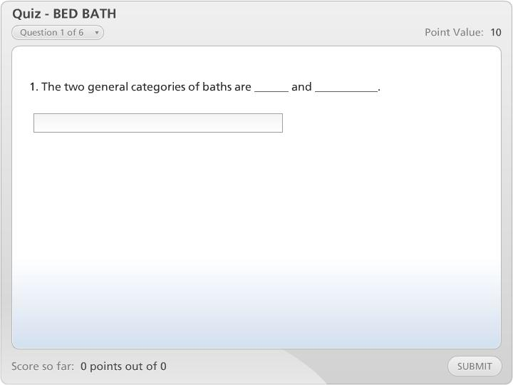



Quiz - BED BATH

Slide 6
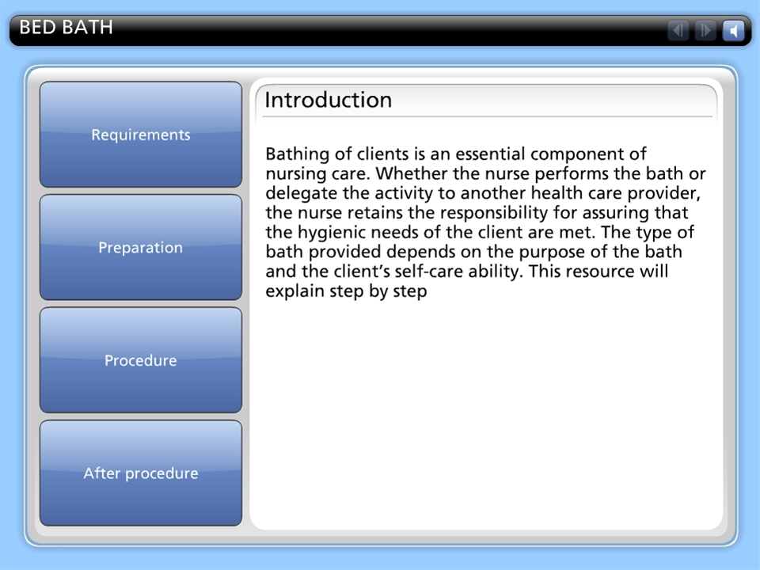

BED BATH

