Slide 1
BED BATH
M. KAMPHINDA-BANDA
12th AUGUST, 2010

Slide 2
BED BATH
INTRODUCTION
Bathing of clients is an essential component of nursing care.
Whether the nurse performs the bath or delegates it to another health care provider, the nurse retains the responsibility for assuring that the hygienic needs of the client are met.
The type of bath provided depends on the purpose of the bath and the client’s self-care ability

Slide 3
CATEGORIES OF BATHS
The two general categories of baths are
Cleaning
Therapeutic.

Slide 4
CLEANING BATHS
Cleaning baths are provided as routine client care
The purpose of a cleaning bath is personal hygiene.

Slide 5
TYPES OF CLEANING BATHS
Shower
Tub
Self-help or Assisted bed bath
Complete bed bath
Partial bath

Slide 6
SHOWER
Most ambulatory clients are capable of taking a shower
Clients with limited physical ability can be
accommodated by placing a waterproof chair in the shower
The nurse provides minimal assistance with a shower

Slide 7
TUB BATH
Tub bath permits washing and rinsing in the tub
Tub baths can also be therapeutic
Clients with limited physical ability should be assisted with entering and exiting the tub

Slide 8
ASSISTED BATH
It is used to provide hygienic care for clients who are confined to bed
Nurse prepares bath equipment but provides minimal assistance usually limited to washing difficult-to-reach body areas such as the feet and back

Slide 9
COMPLETE BED BATH
A complete bed bath is provided to dependent clients confined to bed
The nurse washes the client’s entire body during a complete bed bath
the actions involved in giving a complete bed
bath.

Slide 10
Partial Bath
Consists of cleaning only body areas that would cause discomfort or odour if not washed thoroughly e.g. face, axillae, hands, and perineal area
The nurse or client may perform a partial bath depending on the client’s self-care ability
Partial baths may be performed with the client lying in bed or standing at the sink

Slide 11
DEFINITION
Bathing the entire body of a dependant patient in bed.

Slide 12
OBJECTIVE
To provide the patient with assistance in maintaining personal hygiene and physical comfort.

Slide 13
INDICATIONS
Patients with some physical disabilities that prohibits them from performing certain duties for themselves i.e.
paraplegic patients
Patient on traction
Very weak patients during convalescence

Slide 14
INDICATIONS
Arm disabilities or deformities
Confused patients
Unconscious patients
Post operative patients
Patients with extensive burns

Slide 15
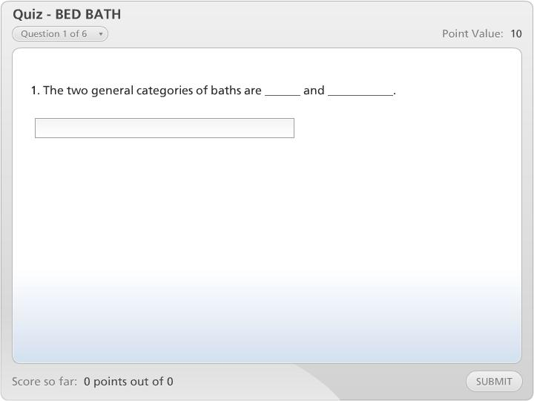



Quiz - BED BATH

Slide 16
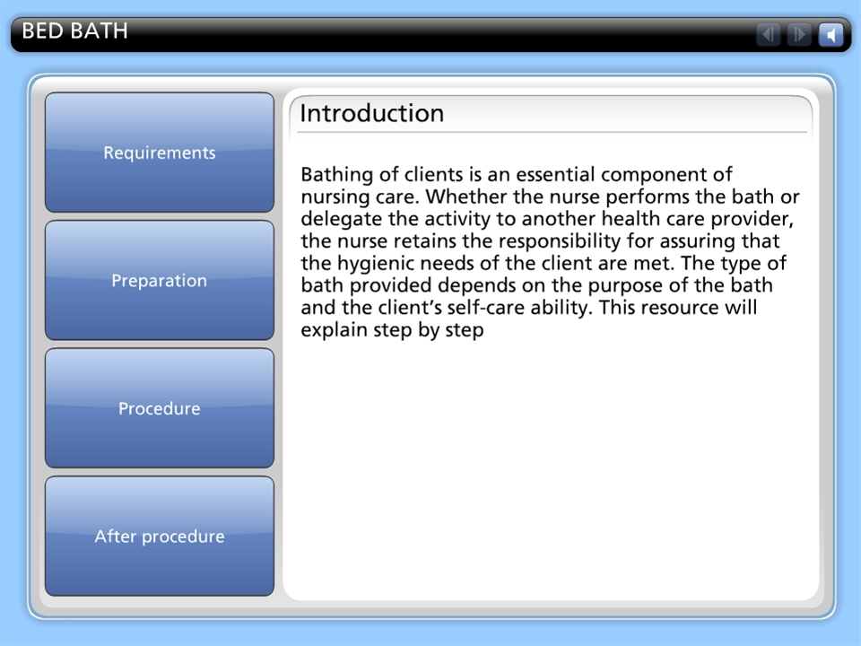

BED BATH

