Slide 1
SCHOOL HEALTH SERVICES
I.CHILINDA
11TH MAY 2011

Slide 2
LEARNING OUTCOMES
Define school health nursing
State the objectives of school health nursing
Explain growth and development of school – age children 6 – 12 years
Explain the elements of school health programme
Describe an ideal school environment and its influence on student’s health
Describe the physical assessment of a school child
State major problems of a school age child
Describe the role of the nurse in school health services
Describe the process of reporting the results of a school health programme

Slide 3
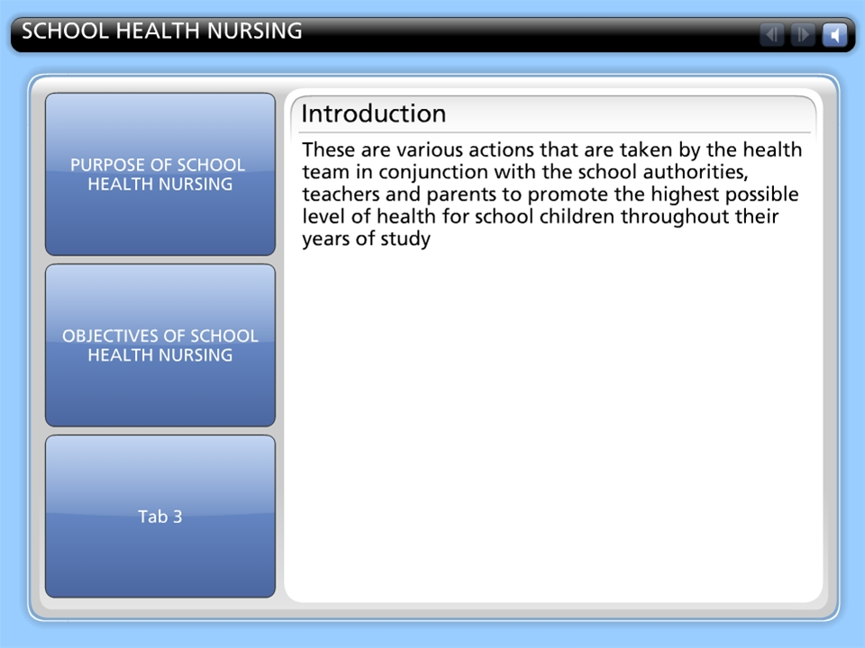



SCHOOL HEALTH NURSING

Slide 4
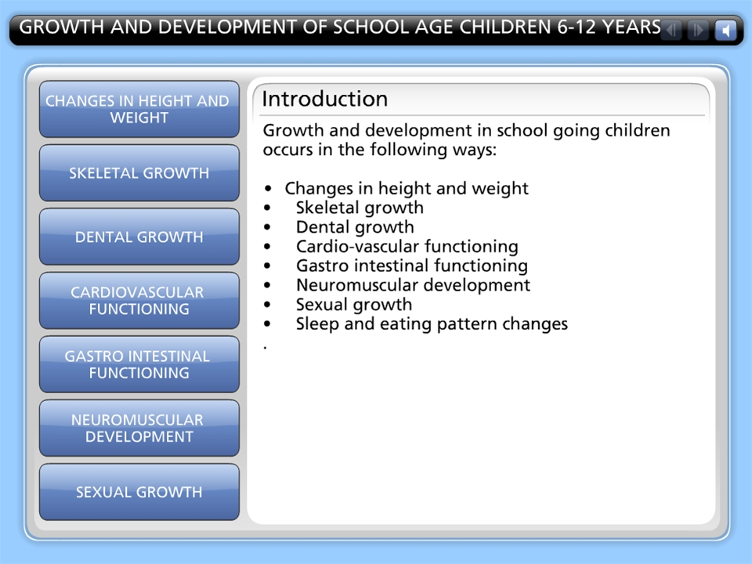
GROWTH AND DEVELOPMENT OF SCHOOL AGE CHILDREN 6-12 YEARS

Slide 5
ELEMENTS/COMPONENTS OF SCHOOL HEALTH SERVICES
Health services designed to protect and promote the health of all pupils and school personnel
Health education
Healthy environment

Slide 6
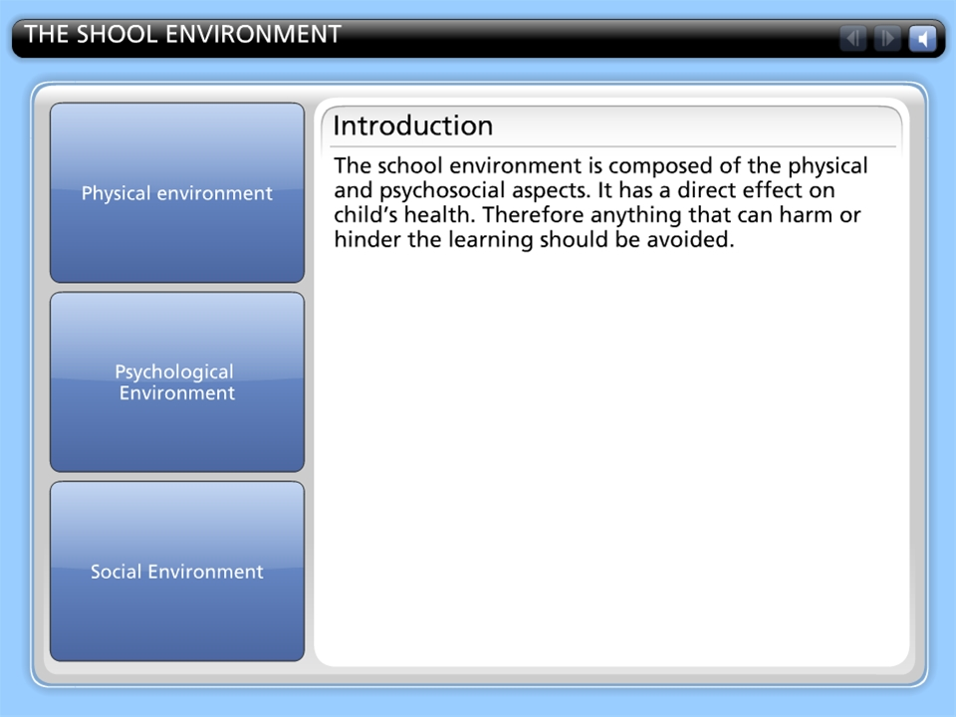
THE SHOOL ENVIRONMENT

Slide 7
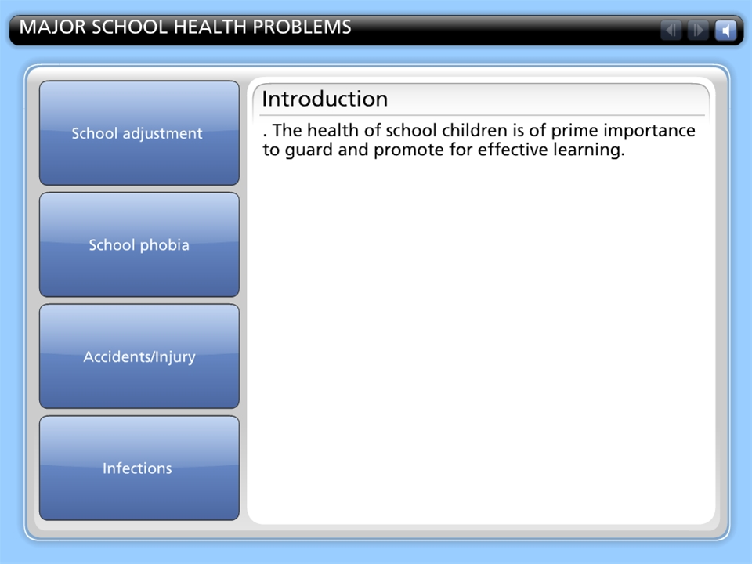
MAJOR SCHOOL HEALTH PROBLEMS

Slide 8
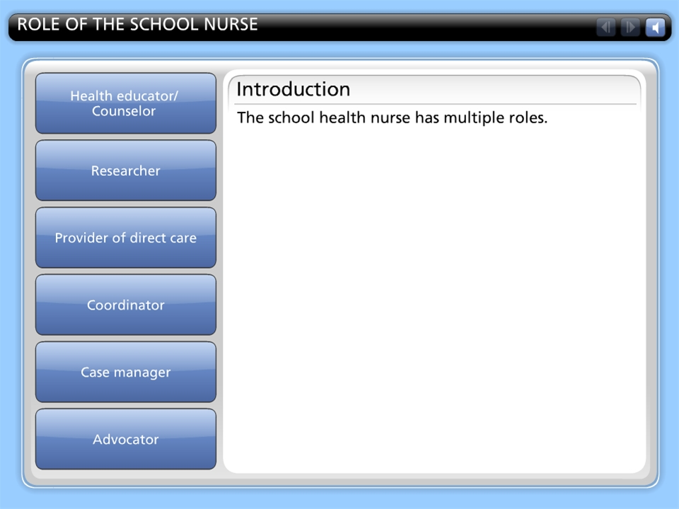
ROLE OF THE SCHOOL NURSE

Slide 9
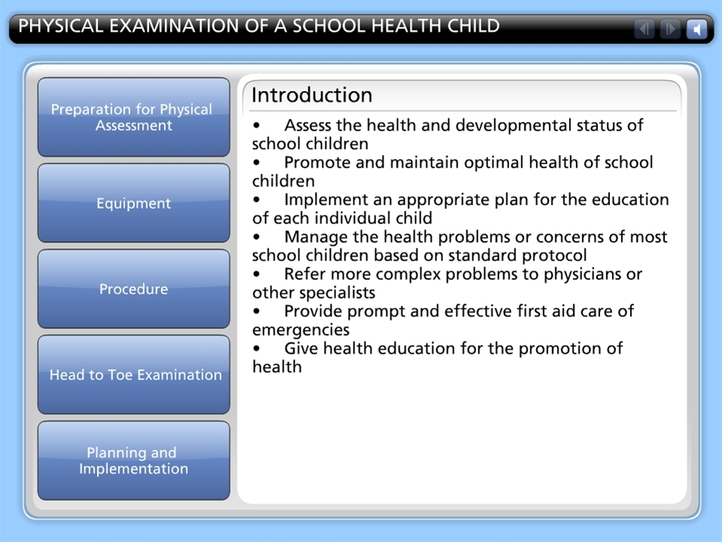
PHYSICAL EXAMINATION OF A SCHOOL HEALTH CHILD

Slide 10
BENEFITS OF SCHOOL HEALTH PROGRAMMES
For the pupil, there is an enhanced physical, psychosocial well being and the ability to take full advantage of opportunity for education
For school staff, there is improved morale and the ability to carry out their mission more effectively and improve their health
For the family and community, both health and economic capacity can be increased for the school and health systems the efficient use of scarce resources can be maximised
For the nation, healthier and better educated men and women can provide a stronger basis for economic development

Slide 11
REPORTING RESULTS OF SCHOOL HEALTH PROGRAMME
Call for a feedback meeting
Invite the following: teachers, parents, PTA, school committee and those who have influential positions e.g village head man, MP, councilors etc
Inform them if objectives have been met
Inform them on positive findings
Inform them on negative findings – not healthy for school children
Ask for their suggestions on improvement
Inform them no of children treated, referred or sent home due to illness

