Slide 1
UNIT 1 THEORETICAL FRAMEWORKS
CHILINDA
2011

Slide 2
THEORETICAL FRAMEWORK FOR COMMUNITY HEALTH NURSING
Learning Outcomes
Explain use of conceptual models in community health nursing
Describe concepts used in relation to:
Systems Theory
Describe the use of the following theories and models:
General Systems Theory
Health Belief Model
Health Promotion Model

Slide 3
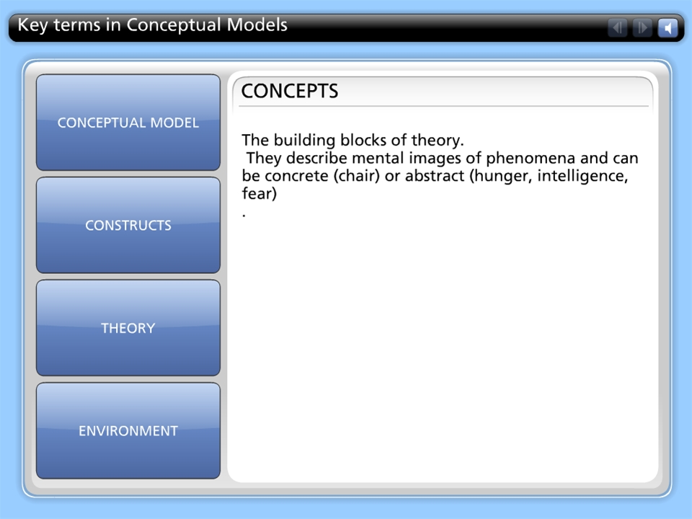



Key terms in Conceptual Models

Slide 4
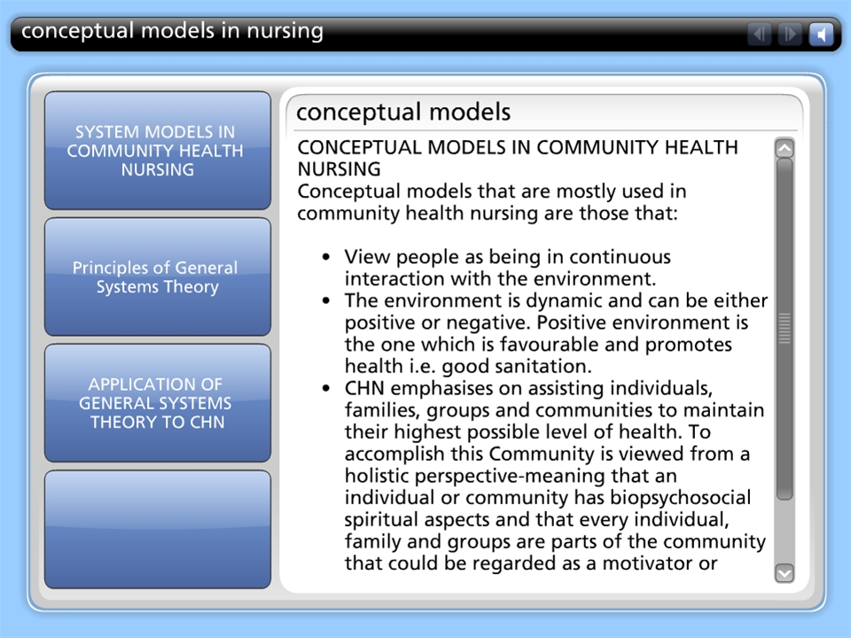
conceptual models in nursing

Slide 5
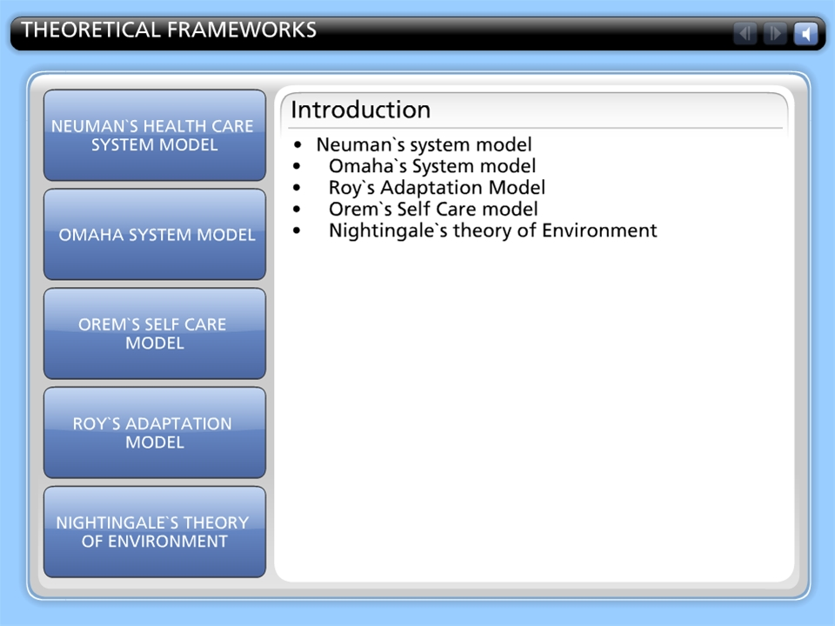
THEORETICAL FRAMEWORKS

Slide 6
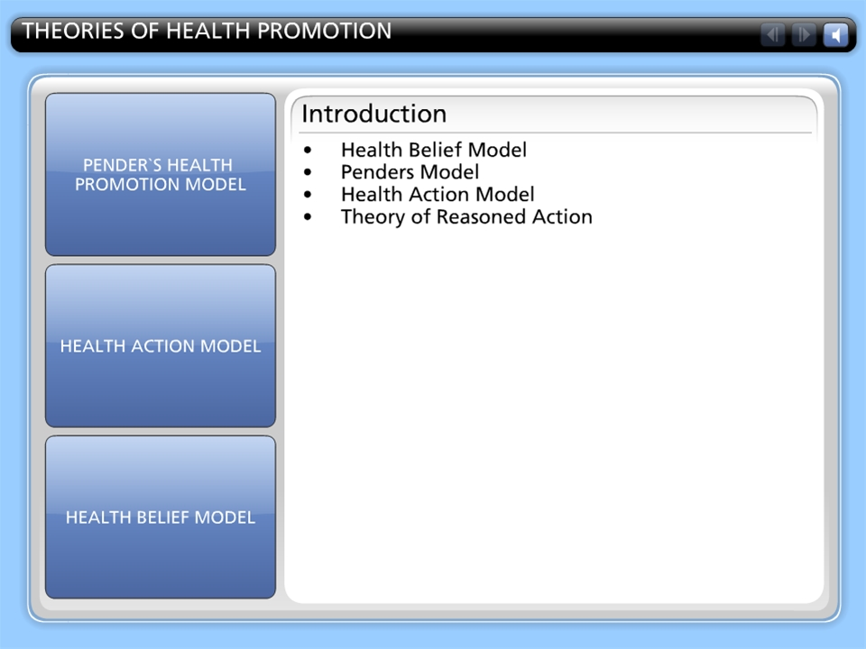
THEORIES OF HEALTH PROMOTION

Slide 7
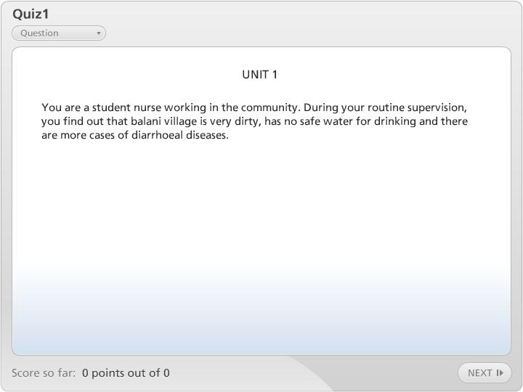

Quiz1

