Slide 1
Mental Disorders
COMMON PRESENTATIONS

Slide 2
Which priority condition(s) should be assessed?
1. The common presentations indicate the need for assessment.
2. If people present with features from more than one condition, then all relevant conditions need to be assessed.
3. All conditions apply to all ages, unless otherwise specified.

Slide 3
Purpose
This presentation will provide the common presentations for different mental illness.
These common presentations inform the right diagnosis.

Slide 4
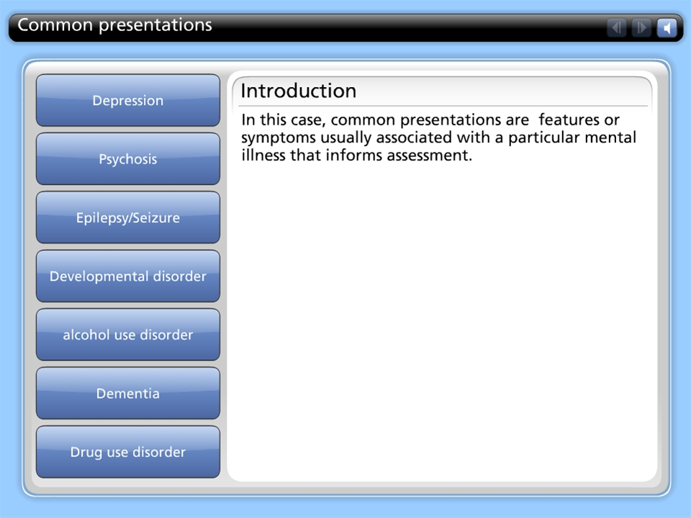



Common presentations

