Slide 1
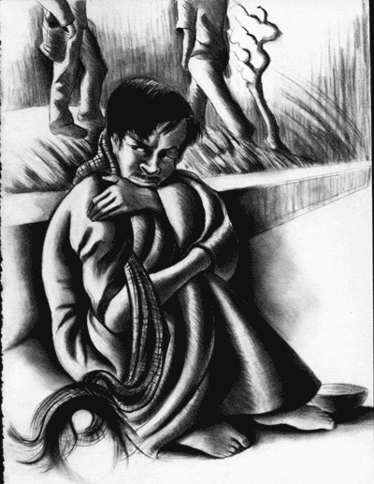
PSYCHOSIS
ASSESSMENT AND MANAGEMENT

Slide 2
Introduction
Psychosis is a mental illness characterized by distortions of thinking and perception, as well as inappropriate or narrowed range of emotions. This presentation will show you how to assess and manage different types of psychotic episodes.

Slide 3
Types of psychotic episodes
Psychotic episodes can be divided into :
Acute
Chronical
Acute manic
Each of these have different assessment and management.

Slide 4
General symptoms of Psychotic disorders
The common symptoms of psychotic disorders are:
Incoherent or irrelevant speech
Delusions
Hallucinations
Withdrawal, agitation, disorganized behaviour
Beliefs that thoughts are being inserted or broadcast from
one’s mind
Social withdrawal and neglect of usual responsibilities related to
work, school, domestic or social activities

Slide 5
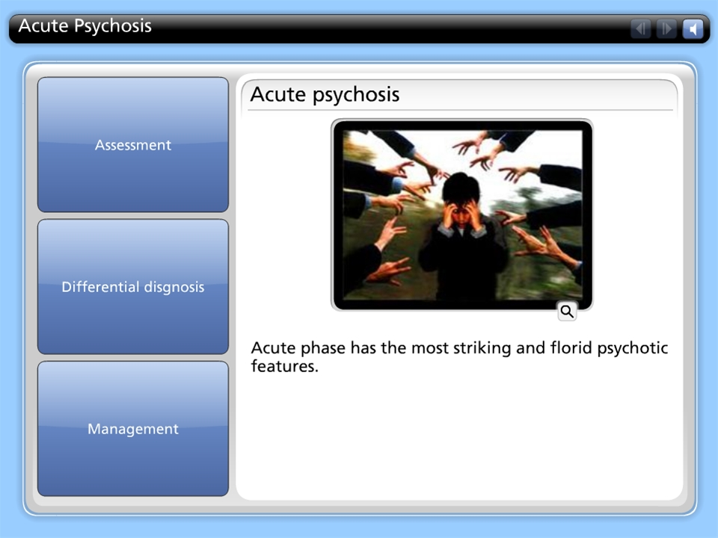



Acute Psychosis

Slide 6
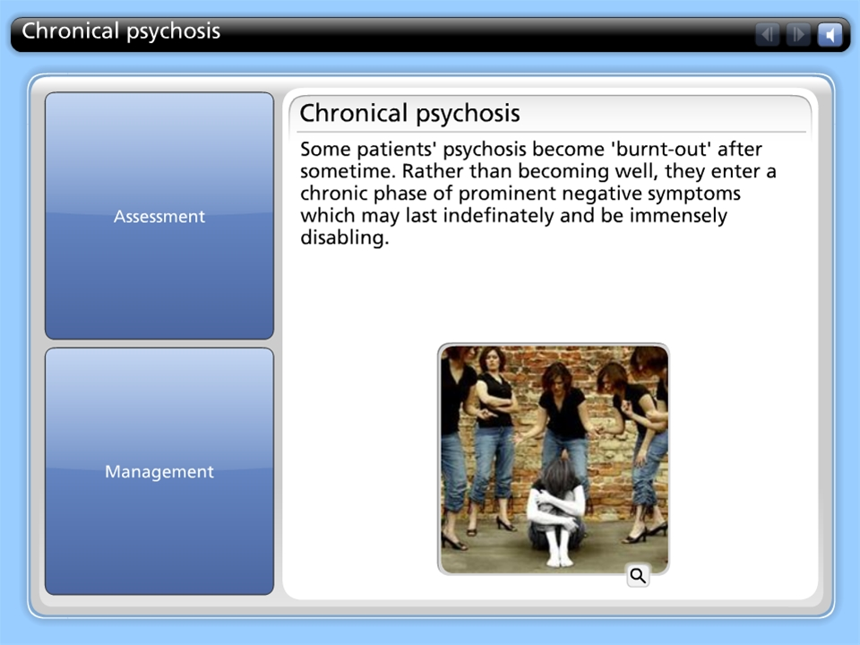
Chronical psychosis

Slide 7
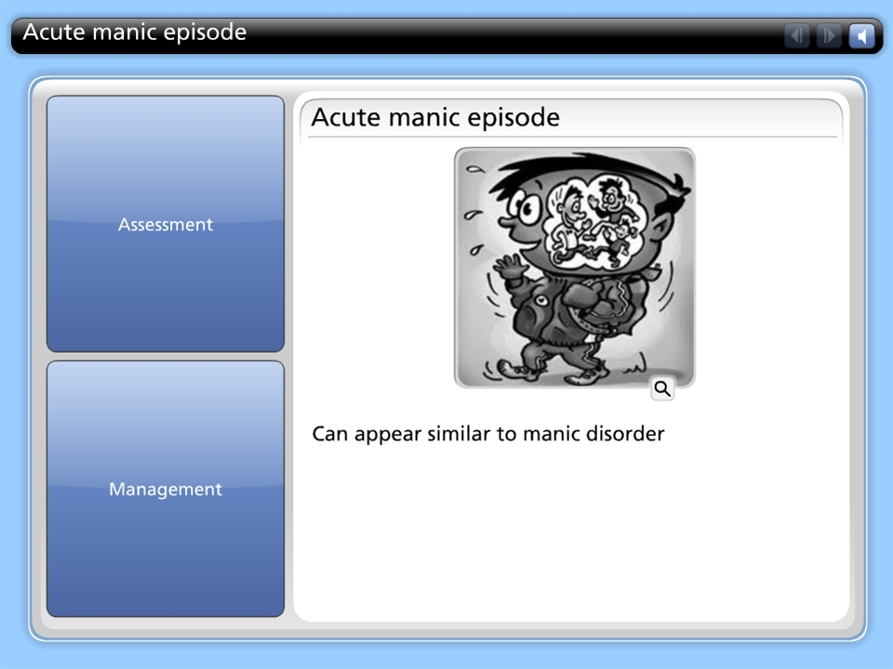
Acute manic episode

Slide 8
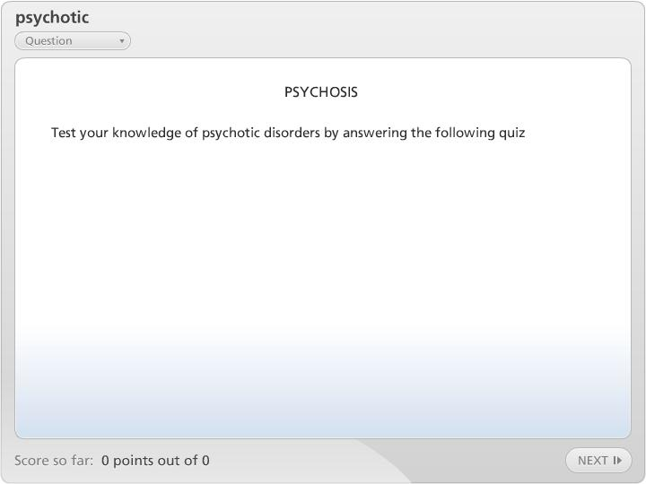

psychotic

