Slide 1
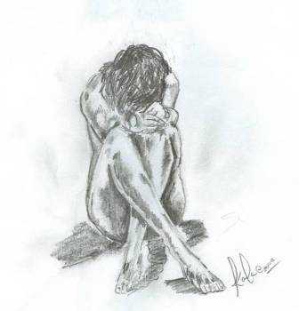
Depression
Assessment and management

Slide 2
Introduction
Depression is a state of low mood and aversion to activity that can affect a person's thoughts, behaviour, feelings and physical well-being
It may include feelings of sadness, anxiety, emptiness, hopelessness, worthlessness, guilt, irritability, or restlessness.

Slide 3
Purpose
The aim of this presentation is to show you how you can assess and manage someone with depression.

Slide 4
Types of depression
Depression episodes can be divided into:
Moderate-severe depression
Bipolar depression
Depression with psychotic features
We will now look at each of the three episodes.

Slide 5
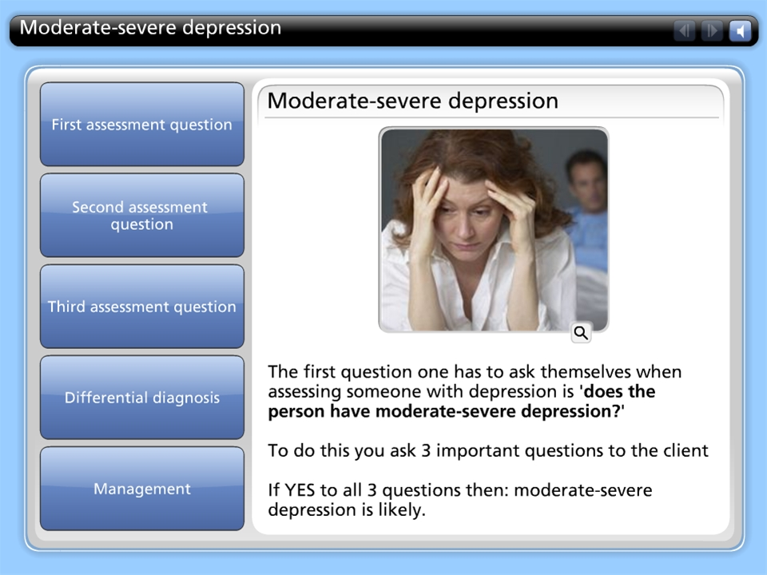



Moderate-severe depression

Slide 6
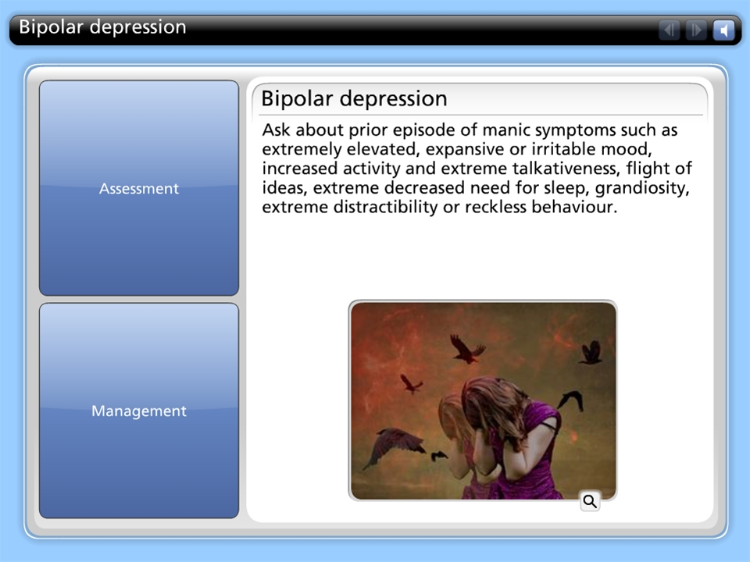
Bipolar depression

Slide 7
Depression with psychotic features
Ask the client about major psychotic features
- delusions,
hallucinations
Stupor
If yes, Augment above treatment for moderate severe depression with an antipsychotic in consultation with a specialist.

Slide 8
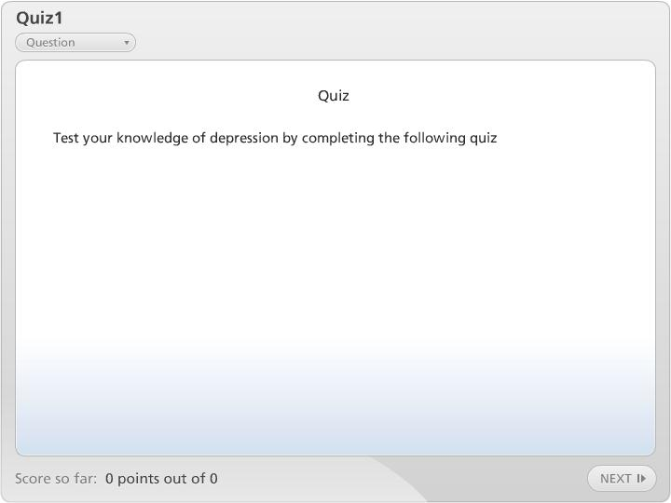

Quiz1

